Slide 1


Welcome!

Slide 2
Compensation for Low Income Groups & Job Support
Closing the gap

Slide 3
Low income groups
When are we talking about a low income?
Single above 18 years € 1.250,19
Married couple or with partner € 1.724,99

Slide 4
What if work is not possible (anymore)?
Unemployment Benefit
Social Assistance Benefit
Not working
Single €1.091,71
Married or partner €1.559,58
€ 2.200 euro (average) | 100% | Old income
€ 1.650 euro | 75% | 3 months
€ 1.540 euro | 70% | Max. 24 for months
Work
Unemployment benefit
Social Assistance Benefit
Example.

Slide 5
Paying all necessities with
Social Assistance Benefit
Single €1.091,71
Married or partner €1.559,58
More help is available
National funds/schemes
Local funds/schemes

Slide 6
National funds
All of these are income-related compensations
Rent compensation
Intended to support residents with low income
Child budget
A budget to support costs for living necessities of children under 18
Healthcare compensation
Compensation to keep health insurance affordable for everyone
Childcare compensation
Compensation for parents who need childcare max. 230 hours a month

Slide 7
Where does the money come from and who decides?
Some funds are distributed from the national government to the municipalities.
Part of the funds are allocated to specific causes.
Municipalities also have a big say in how they spend their money. This often depends on the specific characteristics of the municipality and of course local politics.

Slide 8
Local funds
Special Social Assistance
Participation scheme
Child schemes
  Sports
  Swimming diploma
  Cultural practices
  Schoolcost
  Also: collaborations with local non-profit organisations and churches.

Slide 9
Not: one size fits all
Different cut-off points for maximum income for different schemes and different household types.

Slide 10
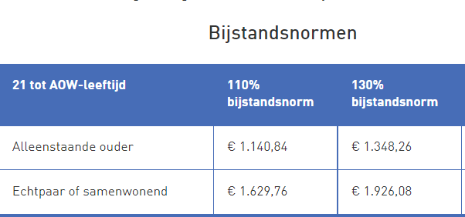
Example
Children till age of 11 → 110% cut off point
Children from 12 up to 17 → 130% cut off point
Single parent →
In relationship →

Slide 11
Trust and simplification
Less administration / use data we already have
Automatically grant access to schemes for multiple years
We do not want to complicate matters for everyone, just to prevent a small group of residents from getting funds they actually should not have access to

Slide 12
Extra time can be used for a tailored approach
Less administration leaves space for a tailored approach
Keeping the end goal in mind
More attention for our residents can save money in the end. Solving problems before they escalate and people get off track.

Slide 13
Thank you for your time
Break

