Slide 2
Welcome! Vítejte!

Slide 3
What are we going to talk about?
Introduction: who am I, what is my job?
Social housing in the Netherlands: origin and contemporary challenges
Decision-making processes
Working against poverty: what do we do?

Slide 4
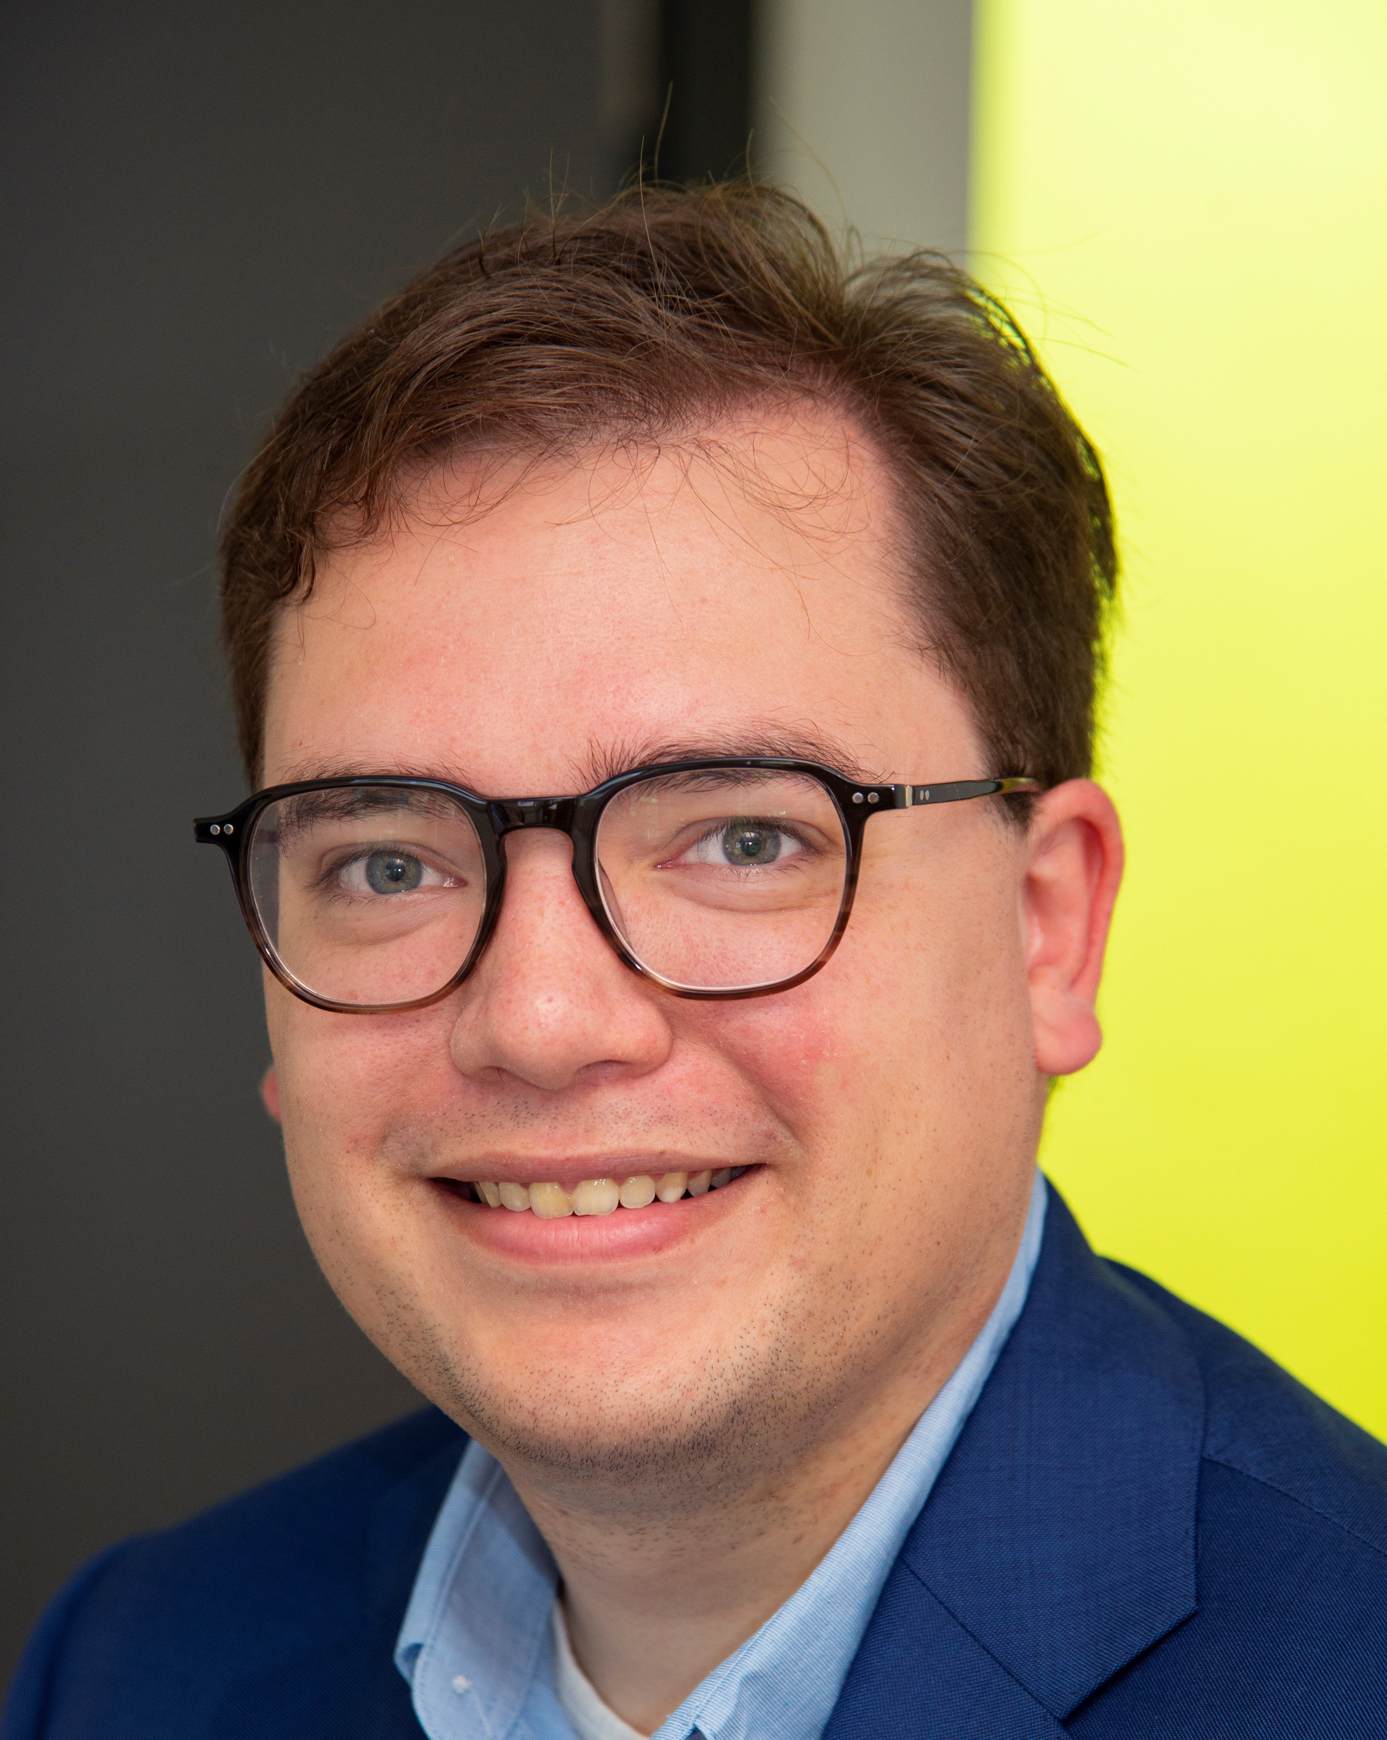
Introduction
Joseph Dommeck
Strategic policy officer at Veluwonen
Background in political science and international relations
And in my free time, I’m a violinist

Slide 5
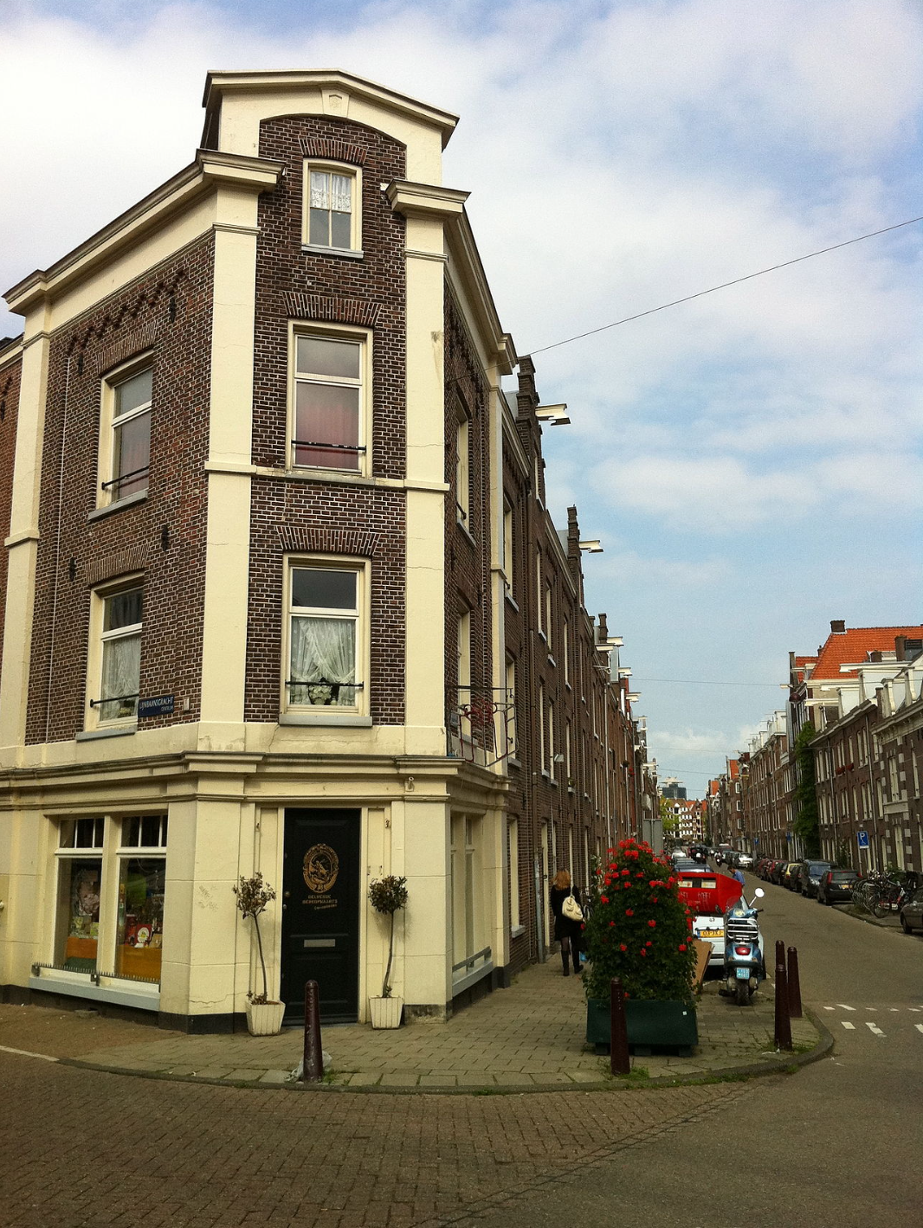
Social housing
Origin in Amsterdam (1852)
Question of local elites: how can we improve the output of our workers?
Answer: by providing cheap, but decent houses (‘efficient’ housing)
i.e.: no philantropy, but capitalist motivations

Slide 6
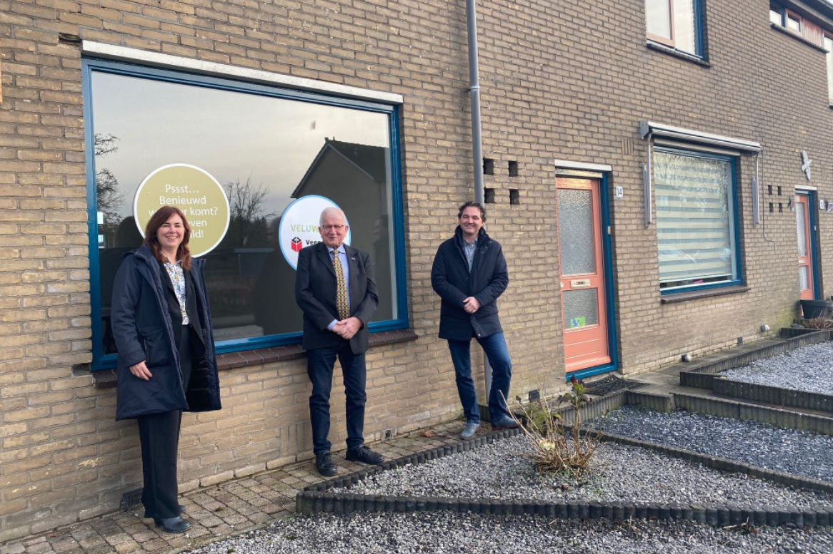
Nowadays
Housing corporations are organizations outside the state (even though this is disputed…)
Goal: to help those households who cannot buy a house or pay high rents.
We don’t work for profit
Special legal status (toegelaten instelling,
permitted institution).

Slide 7
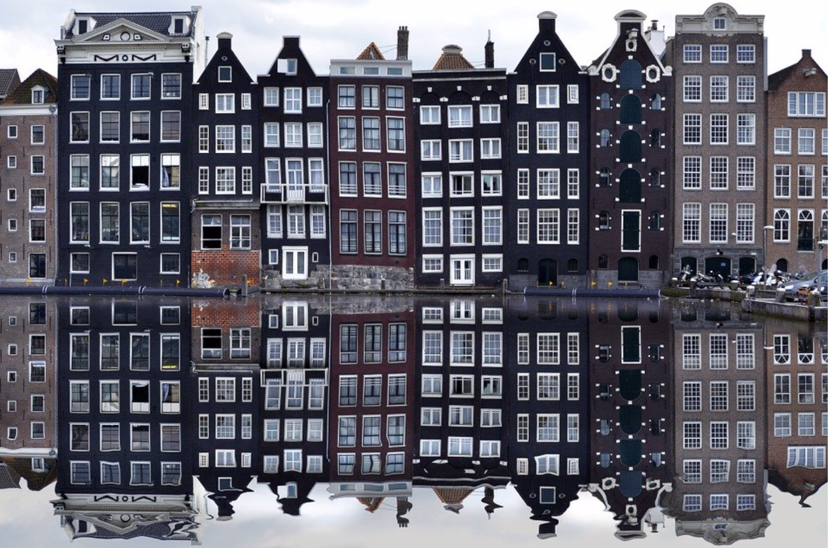
How does it work?
If you annually earn less than ca. 45.000 EUR, then you can apply for social housing (income rules vary)
You get a rent of ca. 740 EUR per month or less (fitting your income)
If needed, you can apply for a ‘rent allowance’ from the state

Slide 8
Contemporary challenges
In the Netherlands, we face some serious challanges with significant effects for lower income households
Not enough houses (housing crisis);
High inflation and growing poverty (caused by increased prices for energy and supermarket prices)
Transition from natural gas to electricity
Stupendous prices for private houses
Rising construction costs
…My goal: how can we face these challenges in the interest of (future) tenants?

Slide 9
Decision-making processes (1)
A director-manager is the ‘boss’ of a housing corporation, but there are a lot of checks and balances.
She/he is controlled by a supervisory board
And to get loans, we are controlled by a ‘fund’ (waarborgfonds sociale woningbouw [WSW])
And at last, the Authority of Housing Corporations (AW) fulfills the ‘check and balance’ from the state.

Slide 10
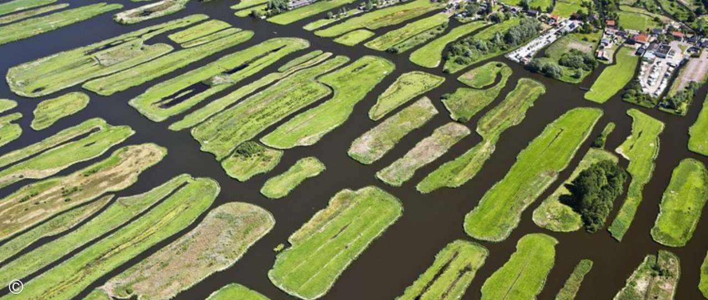
Decision-making processes (2)
But practically, decision-making is highly dispersed, and not hierarchic (compared to international standards)
Tennant’s associations have a legal status in decision-making
Municipalities also have a lot of power in the decision-making
In other words: Poldermodel
Benefit: no authoritative management; highly democratic
Disadvantage: decision-making costs a lot of time

Slide 11
Working against poverty
At Veluwonen, we see poverty as a serious problem
What we do:
Pro-active debt recovery proces
Advise on monthly expenses (Voorzieningenwijzer)
Early detection collaboration
Deep collaboration with municipalities
And sometimes just have a conversation with a tennant.
But we still think that income redistribution and income increase is a task of the central government.

Slide 12
Questions?

