Slide 1
Notes:
SUA – ( Strong out of Poverty) Approach to break through poverty with the people who are affected by poverty. This is about paid work for educated and qualified people: experts of ( generation) poverty and social exclusion.

Slide 2
Presentation for: The European Anti Poverty Network May 12th 2022
By: Riane Kuzee-Hoogeveen &
Thomas de Boer
Notes:
Who are we?

Slide 3
About poverty
Poverty is an injustice and excludes people (inclusion -vision)
‘Systeemworld’ alienates part of the residents (distrust, availabillity)
Poverty is transferred to children (next generation)
Mechanism, patterns and gaps – absence of life skills keeps the inequality of people
Experiences of scarcity gets into personal development (harmed inside, self-stigma, right to exist)
Excluding mechanism = individual and in society
Survival mode = stress = shortage of safety/recognition/attention = influences the development of the brain
It’s complex and effects on all area’s of life
Notes:
These were the thoughts what was the start to make a point of poverty and to work together with the people who are affected by it.
Injustice, systems, stress… The complexity is large.

Slide 4
‘Whatever you do for me but without me,
you do against me’
Mahatma Gandhi
Notes:
MISSION:... Breaking with poverty with the people affected by it

Slide 5
Notes:
Poverty is more then a lack of money. It does something to you inner child, the harmed inside.It is about excluding mechanisms and inherited patterns.
Aswell social emotionally poverty. And there is more knowledge about what poverty / chronical stress (early life stress) does to your health - brain development and hormones in survival mode.
This wordcloud is what poverty is according a class in Drenthe. Experiences of poverty gets to you in your personal development . As child and as mother.

Slide 6
The approach of Sterk uit Armoede
Trained/educated experts of experience functioning as a bridge between living environment and the systemworld. Elements:
Cooperation with councils
Education / development
Work(places) –tandemwork (duo work)
Recognition and distribution
Development of third knowledge source
Notes:
Started in the East of Groningen and Utrecht/Asterdam. Now we are a national Centre of Expertise.

Slide 7
Collective knowledge of experience is complementary and equal
Three sources of knowledge
Notes:
The field of expert worker (EW) positioning next to another professional in a different dicipline.
The reason of this camera tripot is those three equals connecting for the right view and approach.
Practical knowlede – experiental knowledge – scientific knowledge

Slide 8
Employment
Councils
Welfare work
Social community teams
Education
Good start / babycare
Debt care/assistance
Care
Probation service
Knowledge institutions
Notes:
A experience workers are employable in a lot of different fields.

Slide 9
Clients (pool)
Scientific research (e.g. low social status )
Councils and civil society organisations
GGD (regular poverty team + projects)
Alliance of Childpoverty
Pilots province of Drenthe together with councils
SZW (new laws regarding income support)
Consortium of childpoverty
( Divosa – SWN- JEF – NCJ – Sterk uit Armoede)
Different Ministries

Slide 10
The effect of experience work in poverty and social exclusion
For the person her/himself
For their environment (children,family,friends)
For other people living in poverty( from work)
Better approachable
Giving insight to professionals
Change of system

Slide 11
Impact- en MKBA investigation door ‘Alexander Impactscientists’, feb 2021
Representatives of organisations:
Policy and assistance connect better in real terms/targetgroup
Prevention/early detection
Easier to make contact with target group
Easy approachable contact for target group
Expressing issue(s) of targetgroup sooner and better
Target group accepts quicker assistance
Notes:
Cost-benefit analysis

Slide 12
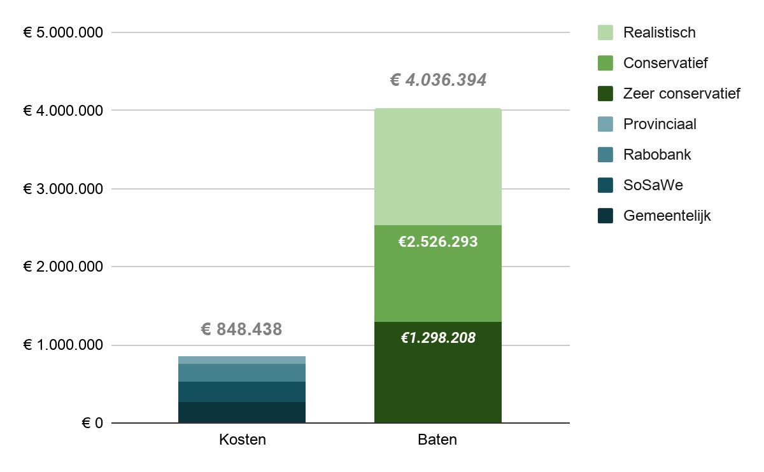
Cost-benefits ratio- summary (2017-2020 – 24 ‘EDers in education’ in- + out)
Notes:
Conservative estimation: 1 on 3 euro’s
Realistic: 1 more then 4 euro’s

Slide 13
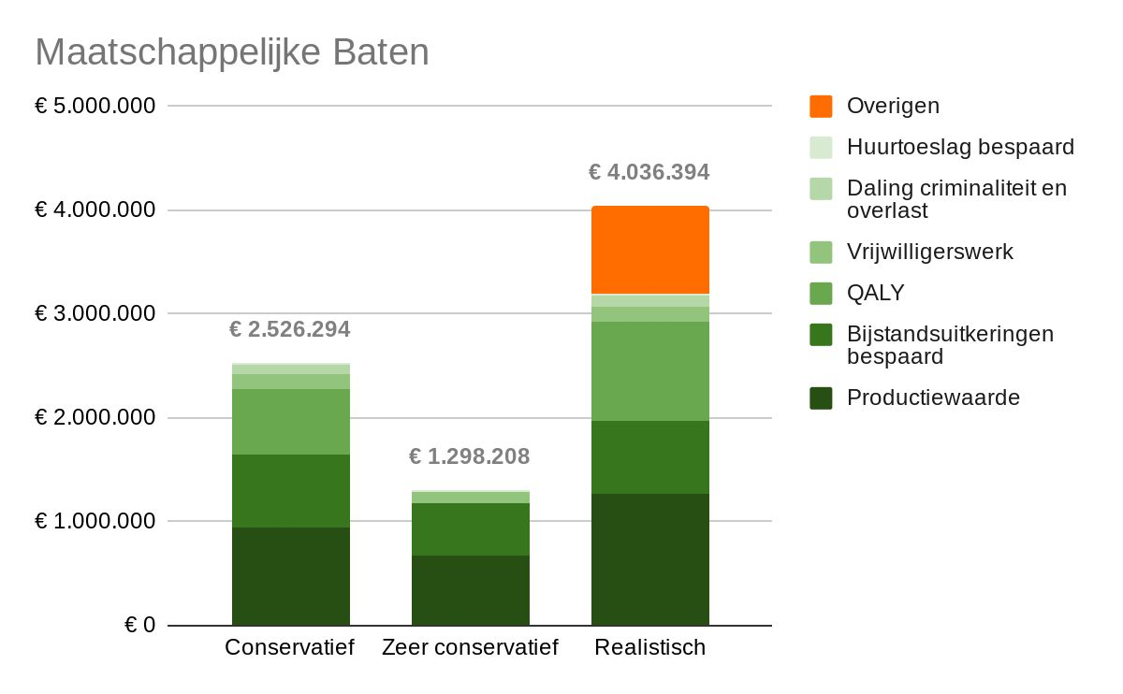
Notes:
Beenefits:
Productionvalue; 12 of 24 immediatly employment = conservative estimate. Beside this expectation = 6 after 2 years
Economization of social security benefits
QALY – Quality Adjusted Life Years (1 year in good health – values granted)
Volunteer work (for those without regular employent yet)
Decreasing crimes and nuisanceDaling
Economization housingbenefits
Possible other savings: healthcare, debt restructuring, effect on children en their environment zorgkosten, – easy for Experience Workers but no hard statistics/expectations
Te noemen
Niet meegenomen is effecten op generaties op langere termijn
en de betekenis voor andere klanten in werk ..

Slide 14
WWW.sterkuitarmoede.nl
Thank you for your interest in our work
Questions? Please ask!
Especially the ones you don’t dare to ask!
And have a safe journey back.

