Slide 1
Welkom
Goede middag! -:- Dobré odpoledne!
Good afternoon!

Slide 2
A little bit about me…
Yorrick van der Ent
28 years old
Rotterdam

Slide 4
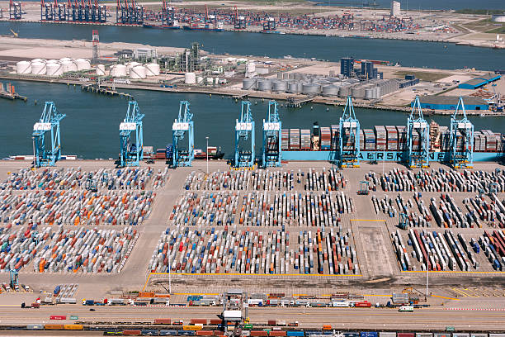
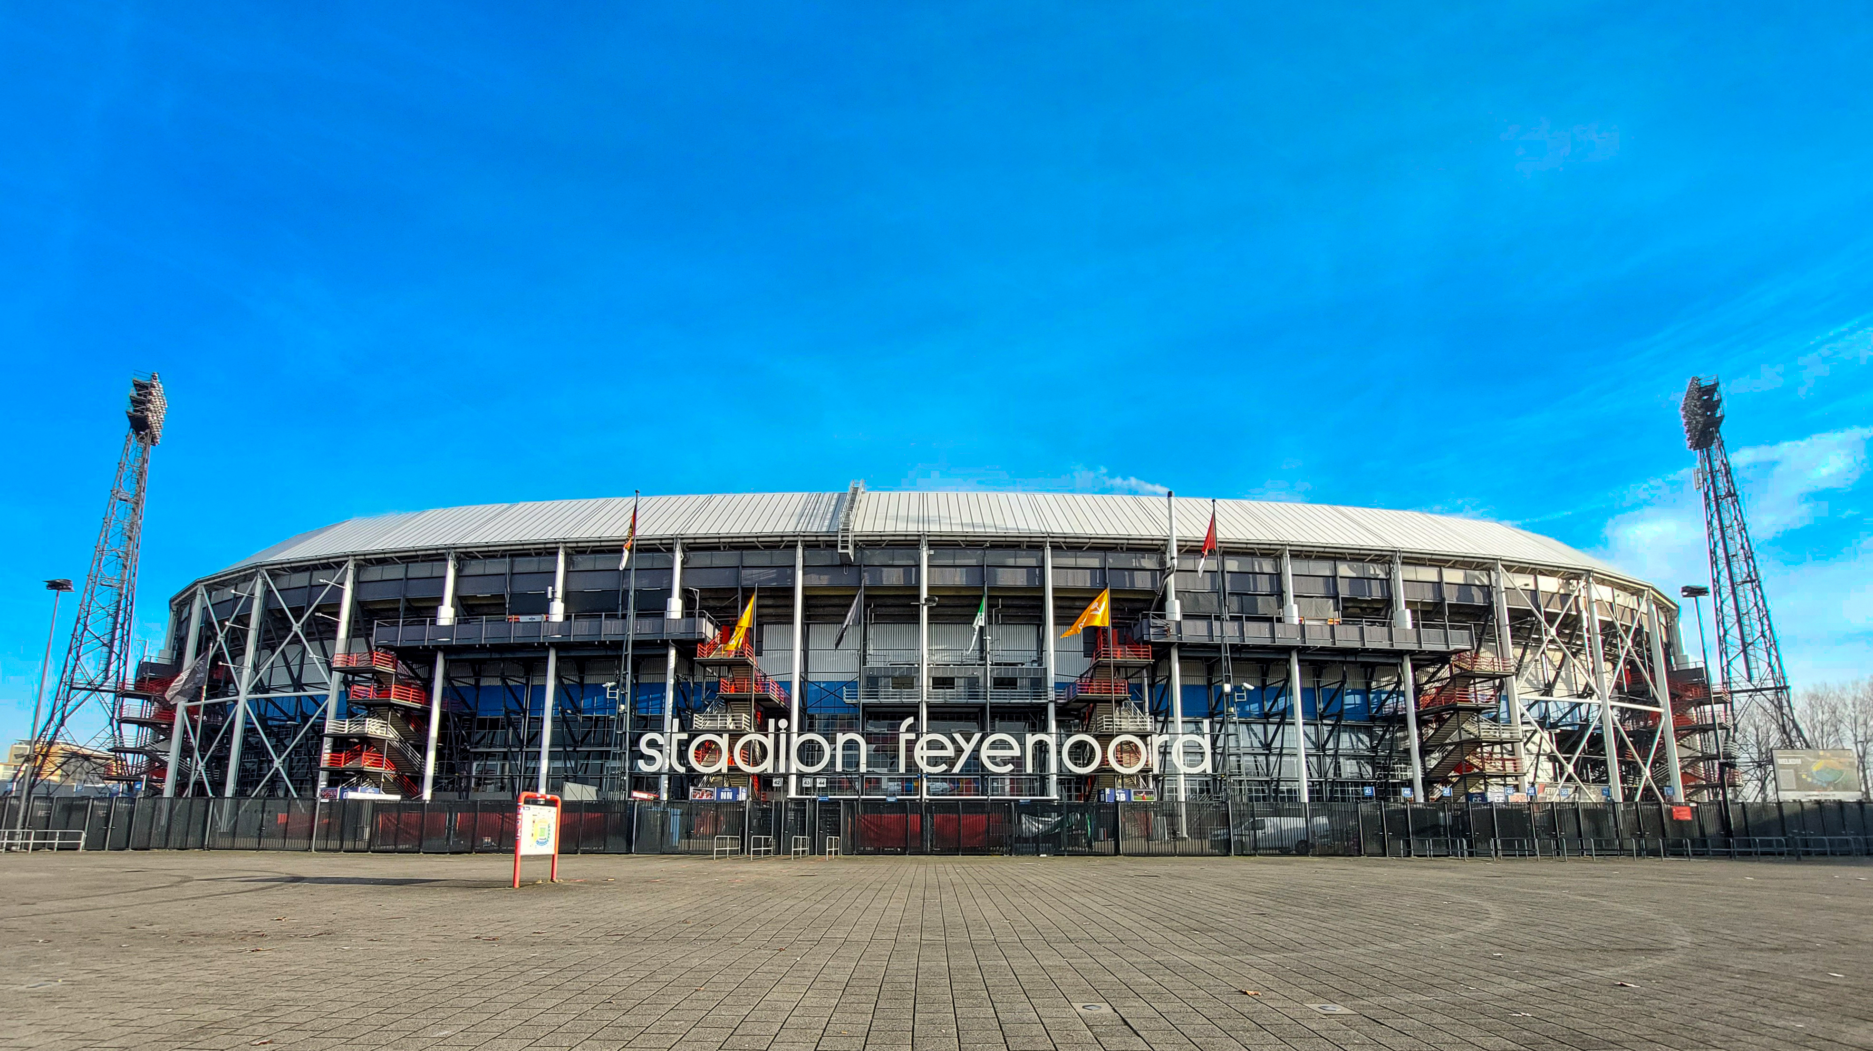
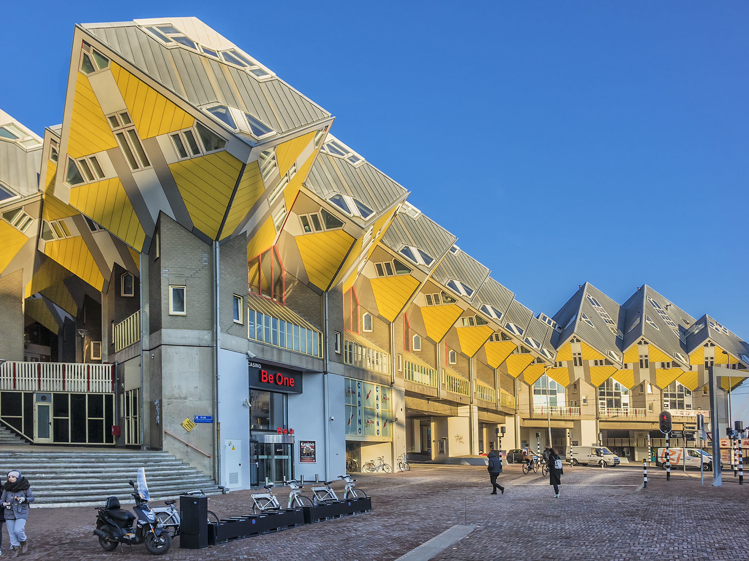
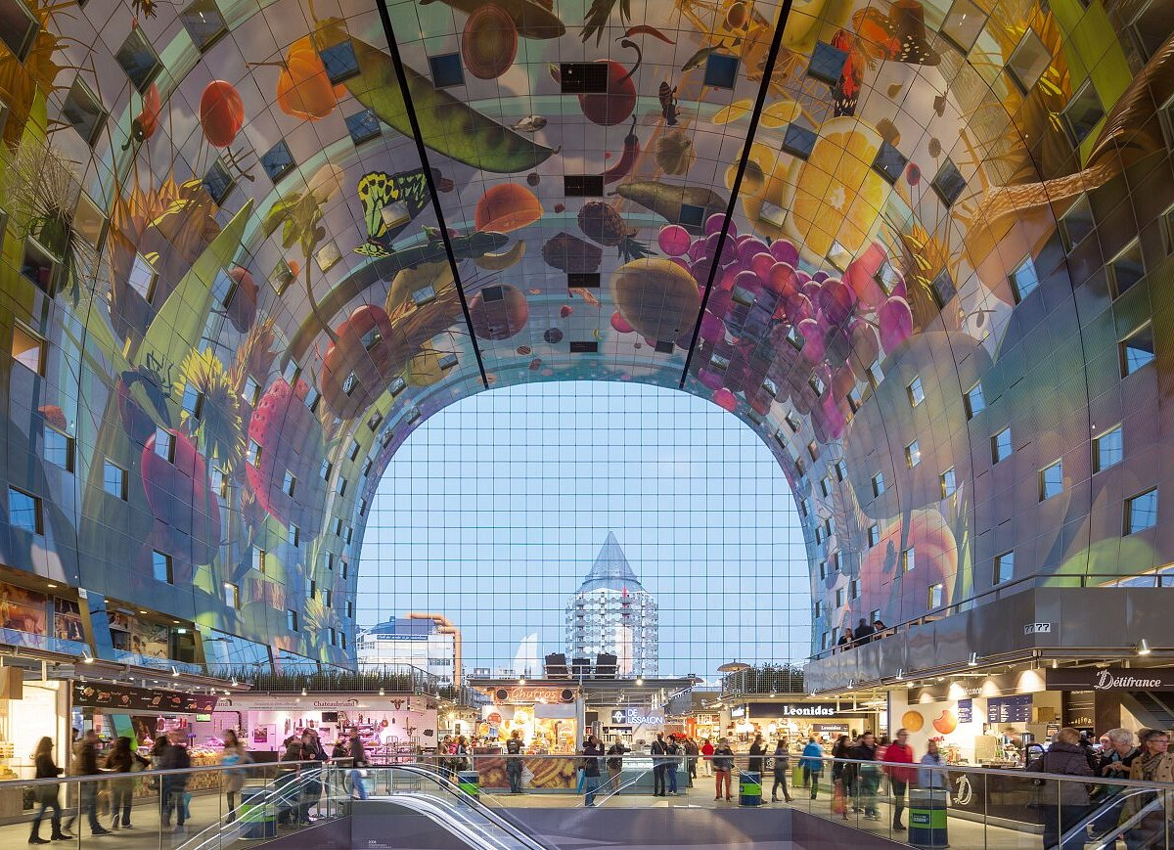
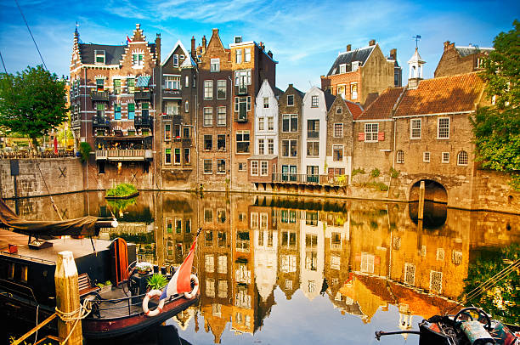
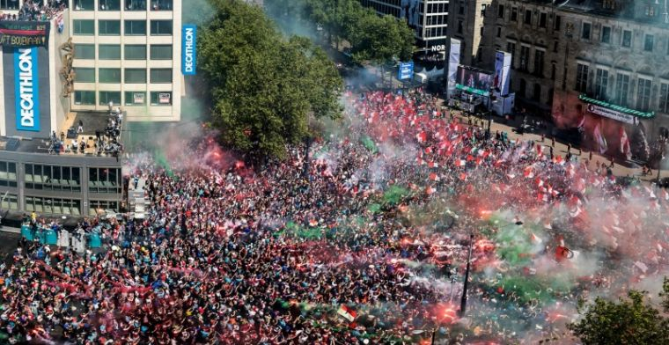

Slide 5
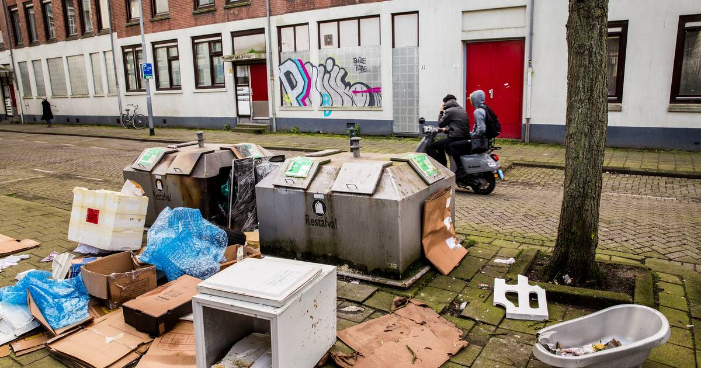
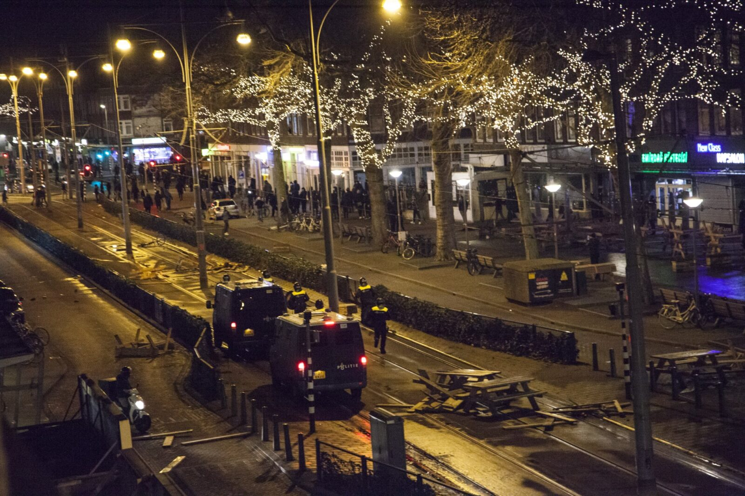
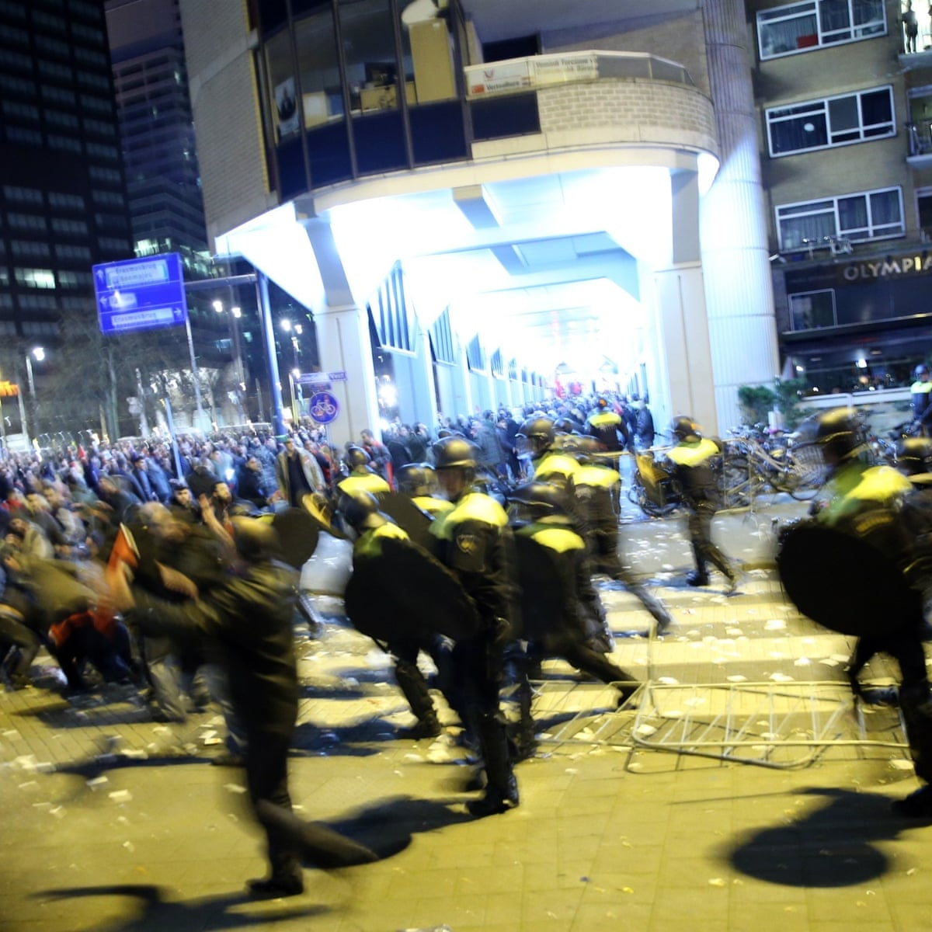
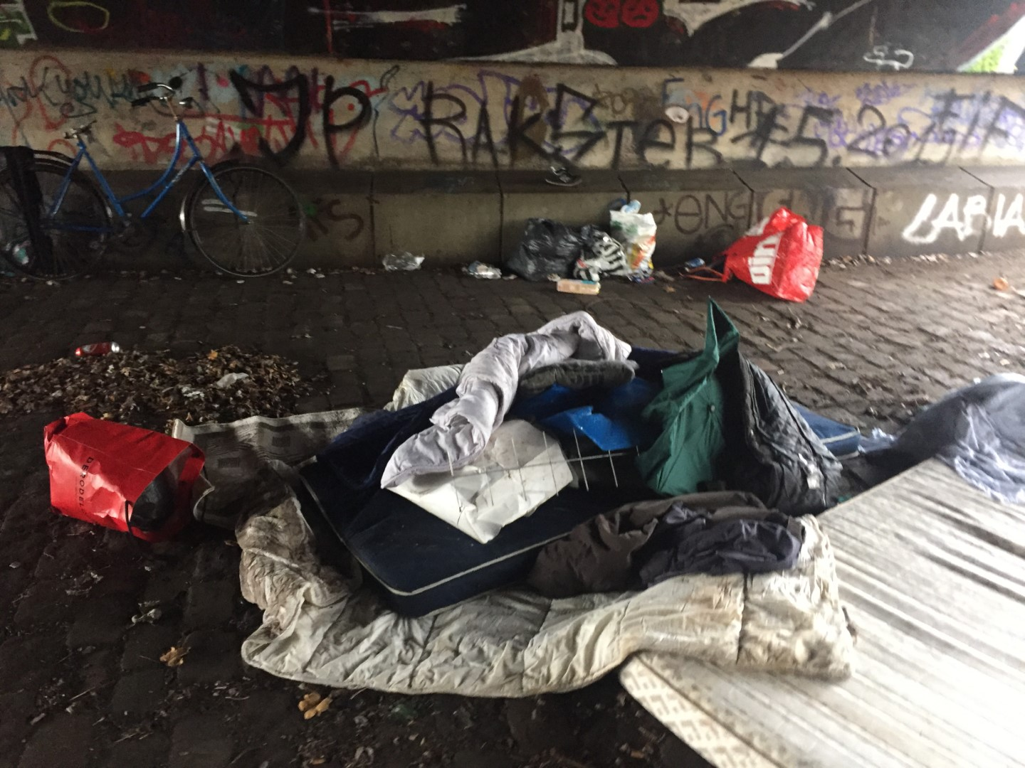

Slide 6
Why am I here?
ExpEx
Young people with
different experiences
Buddy’s
Schools
Municipal workers & City councels
Mental health profesionals
Youthcare workers
z

Slide 7
Young people making a change
Mistakes in the system of child- and youthcare
Changing schools, misdiagnosing, being placed out of your home and more..
Youth participation
Valuable input during the process of making policies
Not making the same mistakes again

Slide 8
My Experience
“A small piece of it”

Slide 9
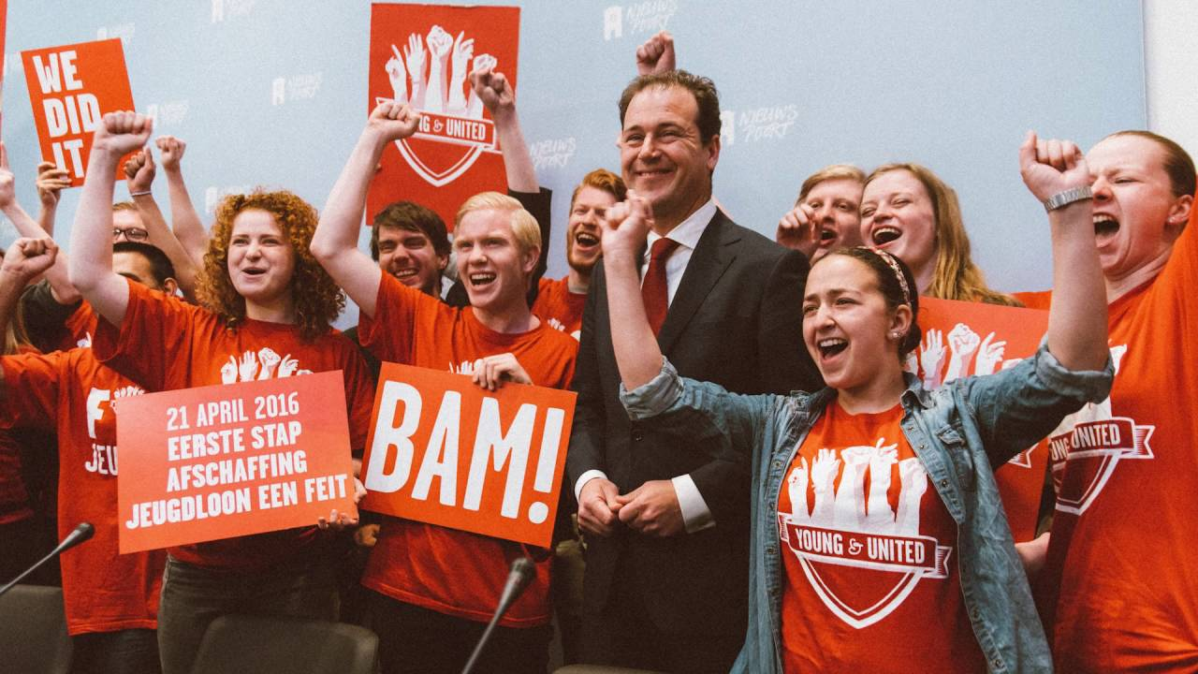
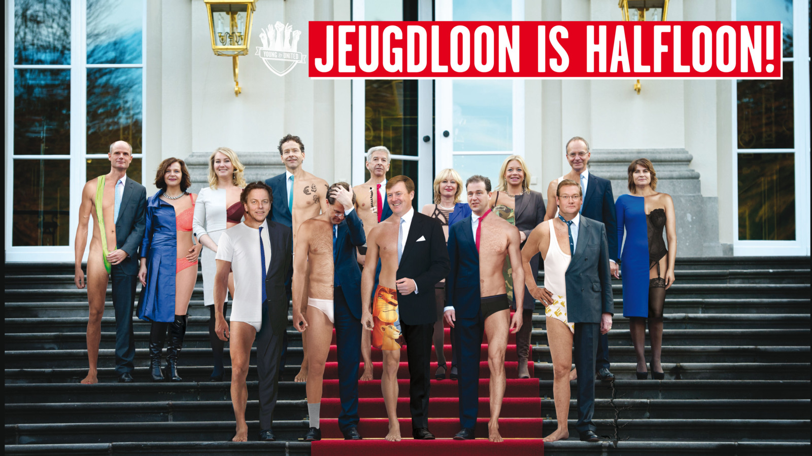
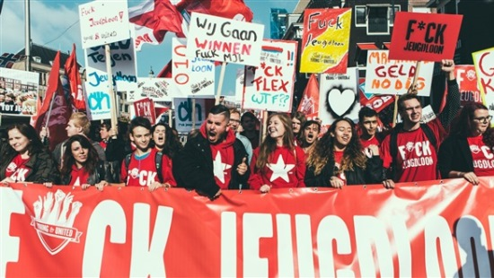
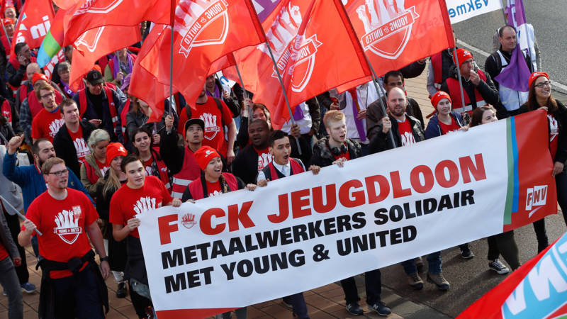
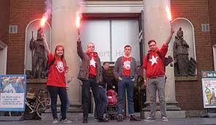
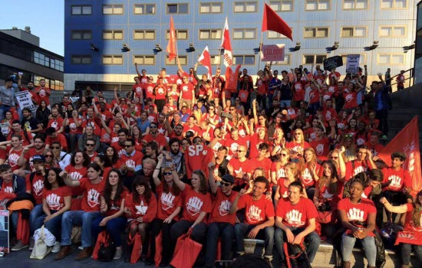
What to do with my experience?

Slide 10
New Places
Hogeschool Rotterdam/Rotterdam Acadamy
ExpEx

Slide 11
Any Questions?
z

